Slide 1
Stock Analysis and Portfolio Management

Slide 2
Content
Forecasting using VAR
Conclusion
Business Problem Statement
Stages in this Project
Business Understanding and Data
Correlation of Daily Returns
CAPM Analysis
ML Model: VAR Forecasting

Slide 3
Business Problem Statement
As a portfolio manager my role requires to analyze a portfolio of stocks to provide consultation on investment management based on client’s requirement.
Investor persona and investment goals:
Ms. Alexandra Kolishnyick is a potential client who requires analysis for her investments
She is the daughter of a famous Ukrainian business tycoon and is in an Ivy League college for her Bachelor's presently.
She intends to form an NGO later with her batchmates to support sub-Saharan African region and is emotionally supported by family over the same.
She plans to invest huge savings from the money sent by her parents during her college & use matured amount for NGO.
She is not eager to disclose any information on investment amount. She is conservative and wants to invest in stocks which shows promise but are also stable. She wants a comprehensive report on all the metrics used to devise the investment strategy.

Slide 4
Stages in this Project
Business Understanding
Data Understanding & EDA
Data Preparation
ML model Building
Creating train and test sets
CAPM analysis
Data
Understanding
Metric Evaluation
Model Validation and Conclusion
Time Series Forecasting: series of steps involved in the analysis

Slide 5
Data Understanding & EDA
Dataset has 5217 records from 1st October 2010 to 30th September 2020 which include 12 stocks of leading companies listed in New York Stock Exchange(NYSE). The columns in the data are Date, Open Price, Close Price, High Price, Low Price, Adjusted Close Price, Volume Traded.
The stocks belong to different sectors with S&P 500 being the index.:
Technology/IT
Travel/Aviation/Hospitality
Banking/Financial Services and Insurance
Pharmaceuticals/Healthcare/Life Sciences
Analyzed the risk, return, min values, max values, daily returns, moving averages and correlation.
Data
Understanding
Data Preparation & Cleanup
Exploratory Data Analysis
Data Preparation for Modelling
Model Building
Model validation
Metric Evaluation

Slide 6
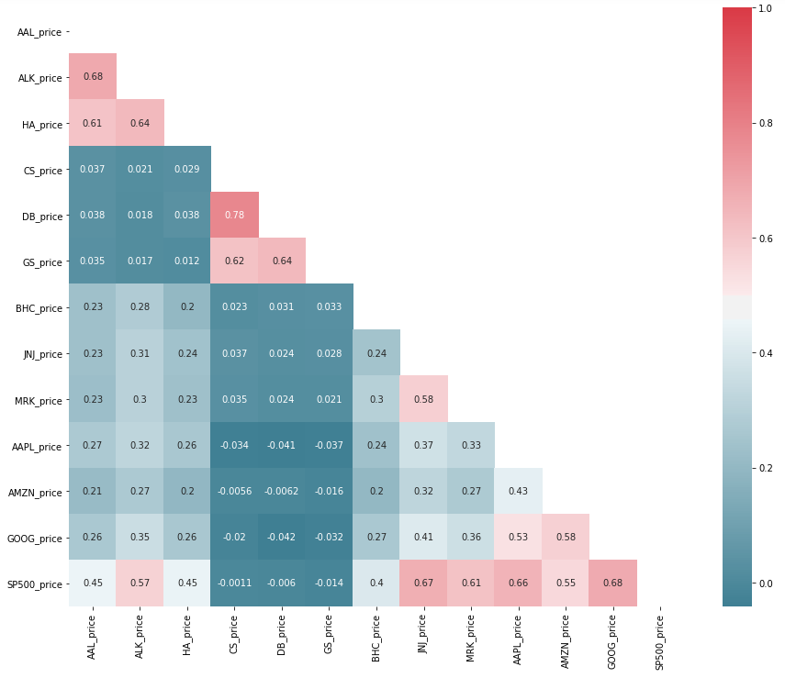
Correlation of Daily Returns
The Correlation is observed between vairables
Tech sector and market
Credit Sussie and Duetsche Bank
Johnson and market
Heat Map showing Correlation of daily returns for all stocks: This helps in determing sector performance

Slide 7
CAPM Analysis
Capital Asset Pricing Model (CAPM) describes the relationship between the expected return of assets and the systematic market risk
Beta is a measure of the volatility or systematic risk of a security or portfolio compared to the entire market(S&P500)
CAPM analysis performed resulted in the stocks with stable beta values and expected returns higher than the market:
Alaska Air Group
Hawaiian Holdings
Apple
Amazon
Google
Data
Understanding
Data Preparation & Cleanup
Exploratory Data Analysis
Data Preparation for Modelling
Model Building
Model validation
Metric Evaluation

Slide 8
ML Model: VAR Forecasting
Vector autoregression(VAR) is a multivariate time-series forecasting methodology that is used to capture the influence of multiple time-series values on each other. That is our primary ML model to forecast future stock prices.
Steps in implementation of VAR model:
The Selected set of Stocks using CAPM approach is fed as Data to the VAR model and was split into 70% train and 30% test set.
Stationary test showed that all the series were stationary
A model was fit with lag order 1
VAR forecasted values are very close with actual values.
Metrics chosen: RMSE [Root Mean Squared Error] and MAPE values gave low values indicating the VAR model forecasted the future prices correctly.
Data
Understanding
Data Preparation & Cleanup
Exploratory Data Analysis
Data Preparation for Modelling
Model Building
Model validation
Metric Evaluation

Slide 9
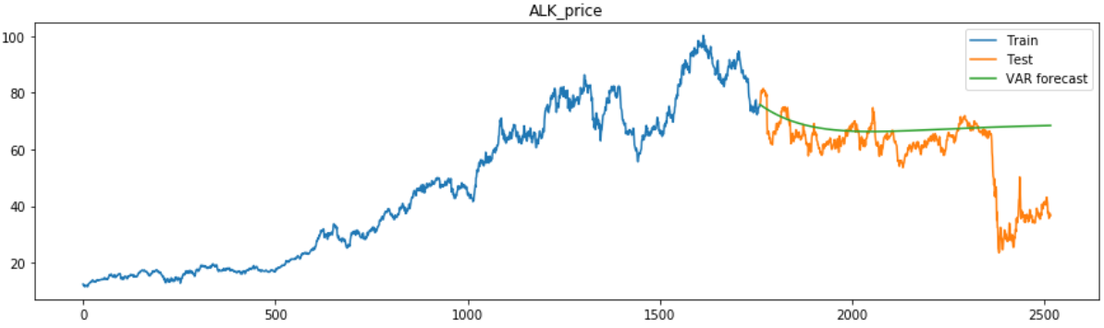
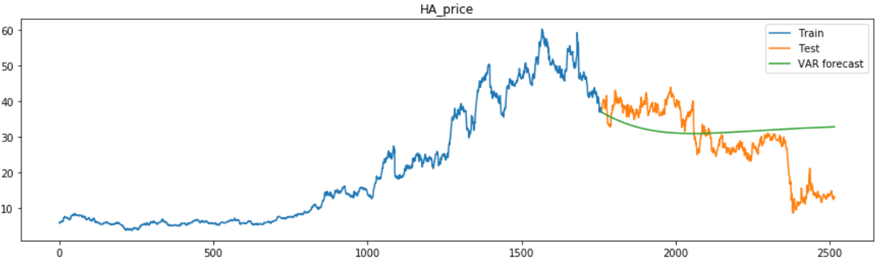
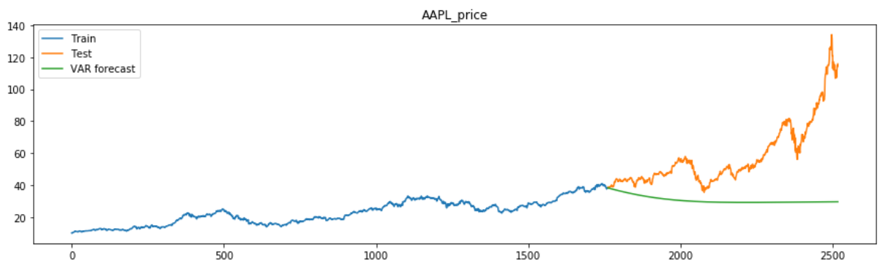
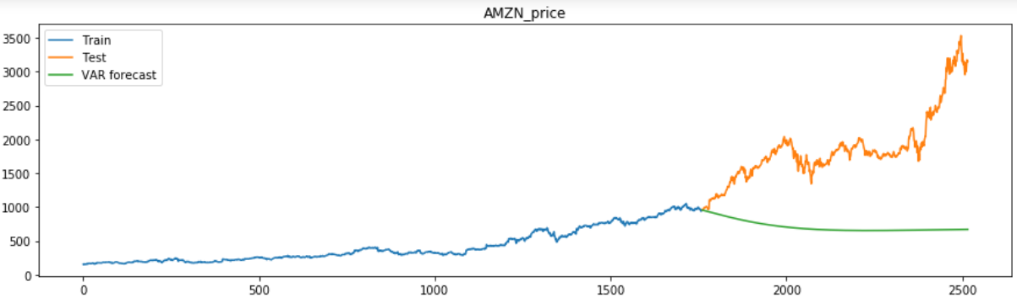
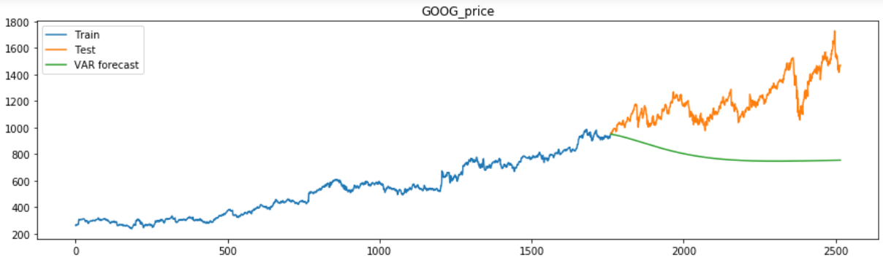
VAR Forecast Plots
Train, Test and Forecast Plots

Slide 10
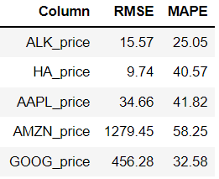
Conclusion
By CAPM approach and VAR forecasting we can conclude that the stocks showing highest expected returns and are also most stable as required by our client Ms. Alexandra:
Google - 12.46%
Apple - 13.02%
Amazon - 12.27%
Alaska Air - 14.96%
Hawaiian Holdings - 14.98%
Also these stocks gave us the least RMSE and MAPE values when predicted using VAR model indicating model’s robustness.

